Slide 1



Quantum Financial Forecasting
Alex, Florian, Leonard, Mohamad

Slide 2
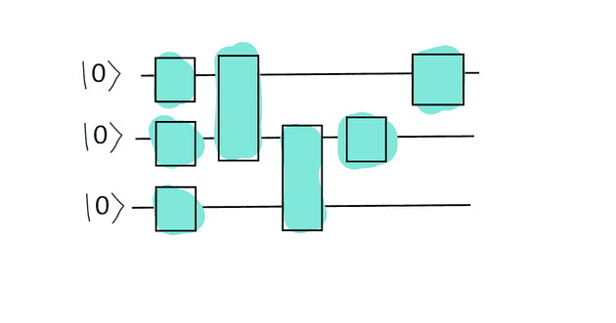
What did we achieve?
QLSTM modifications from mathematical functions to stock data
Stock data gathered from AlphaVantage (30 stocks, last 2 years)
Meeting about autoencoders with Michael Kölle
Finalization of QRNN model
Performance of QLSTM vs. QRNN vs. Baseline
Consideration of additional indicators
Quantum Financial Forecasting

Slide 3
Our Models QRNN and QLSTM
Training phase:
Train on 70% of the stock data
Consider the previous 10 days for next-day prediction
Calculate loss and update parameters, 20 epochs
Testing phase:
Test performance on 30% of the unseen stock data (last 6 months)
Consider the previous 10 days for next-day prediction
Quantum Financial Forecasting

Slide 4
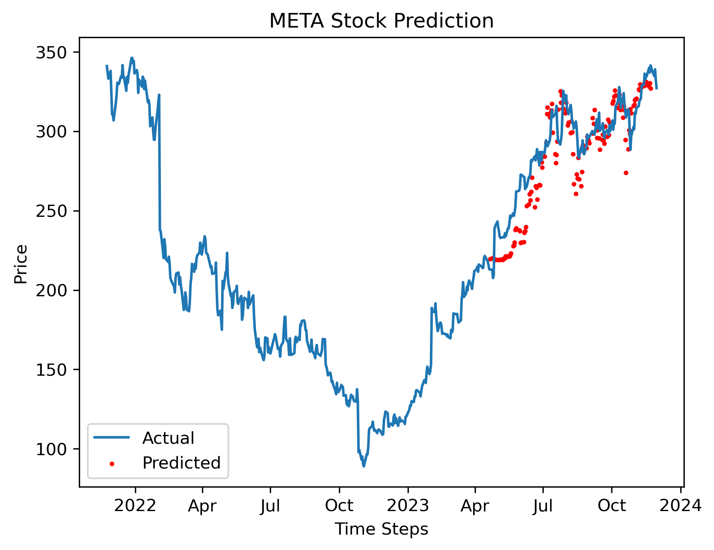
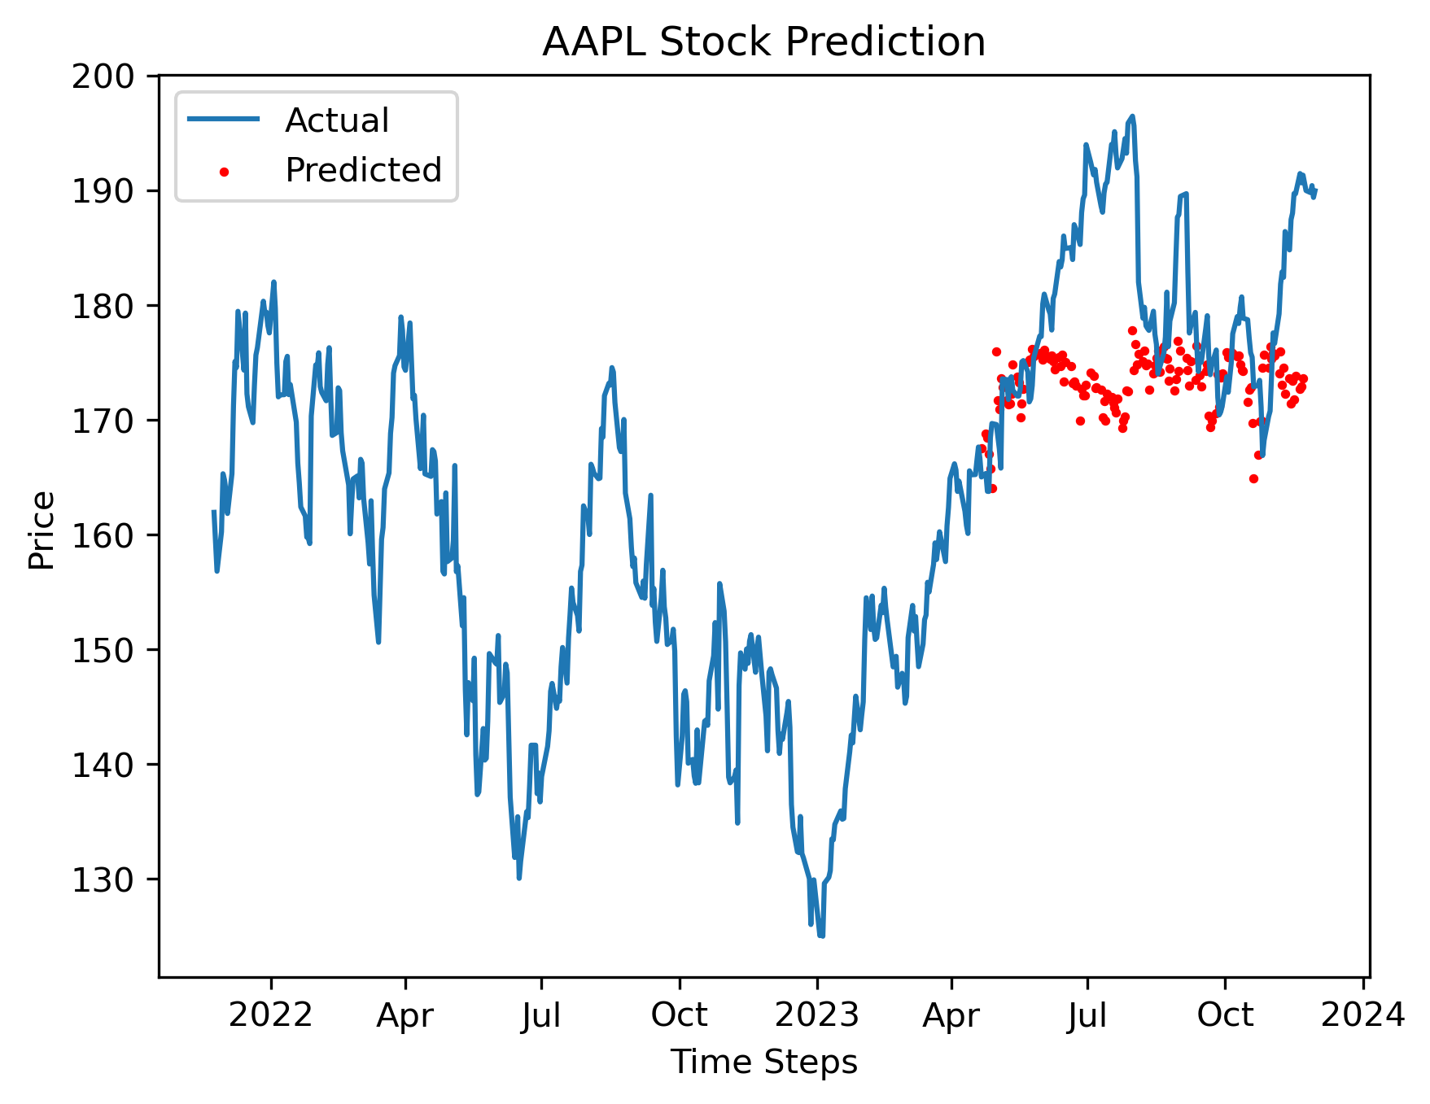
Results QRNN
TRAIN
TEST
TRAIN
TEST
Quantum Financial Forecasting

Slide 5
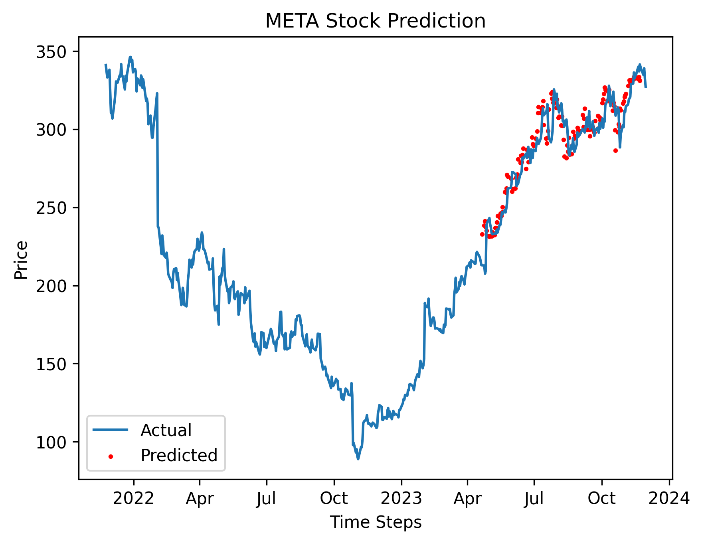
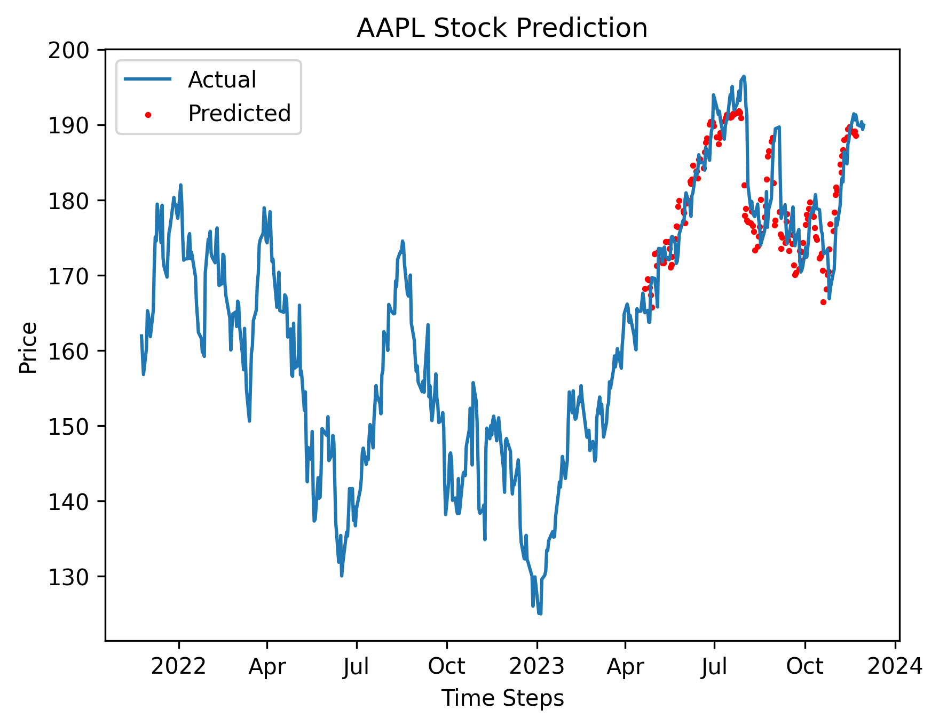
Results QLSTM
TRAIN
TEST
TRAIN
TEST
Quantum Financial Forecasting

Slide 6
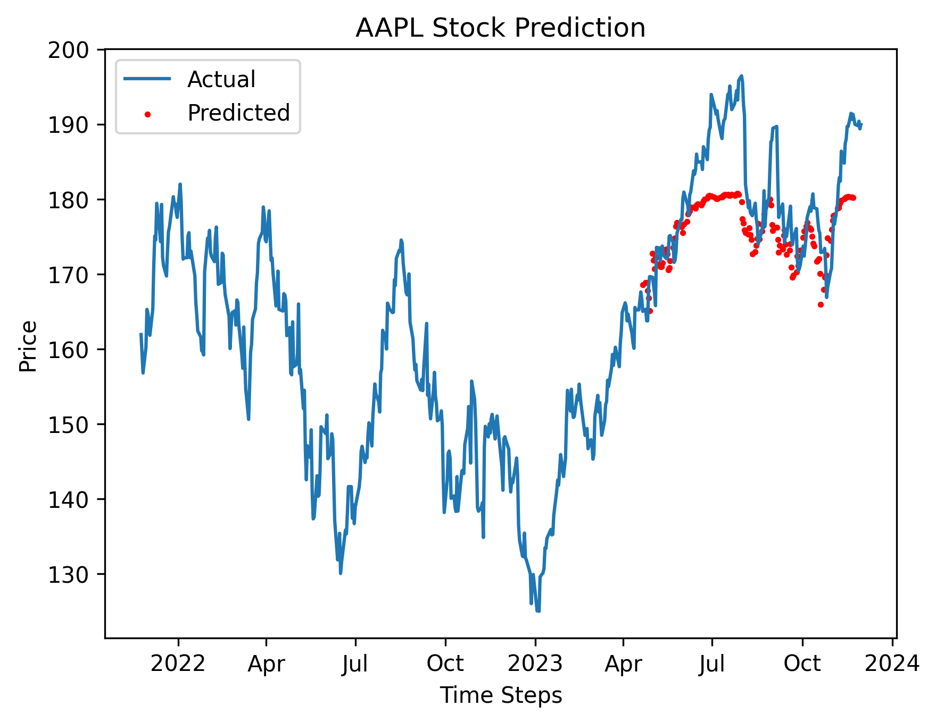
Results QLSTM vs Baseline
QLSTM
Baseline - LSTM
TRAIN
TEST
TRAIN
TEST
Quantum Financial Forecasting

Slide 7
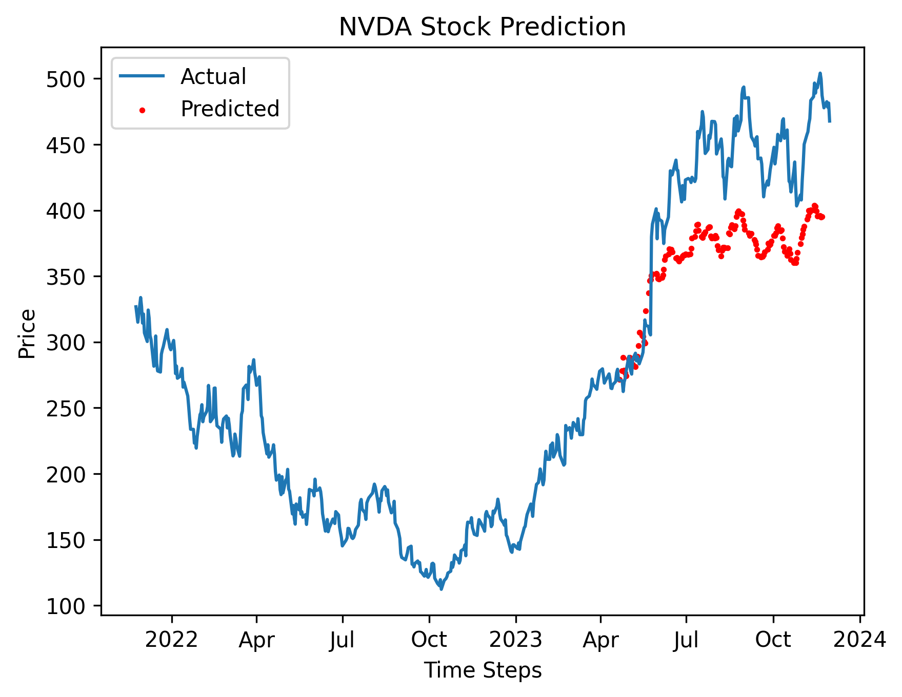
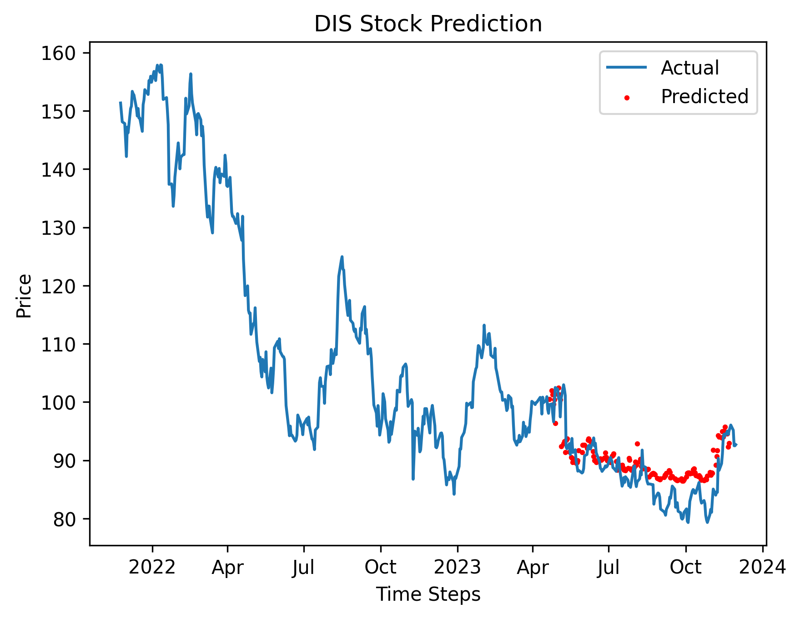
Challenges in Predictions - QLSTM
Quantum Financial Forecasting

Slide 8
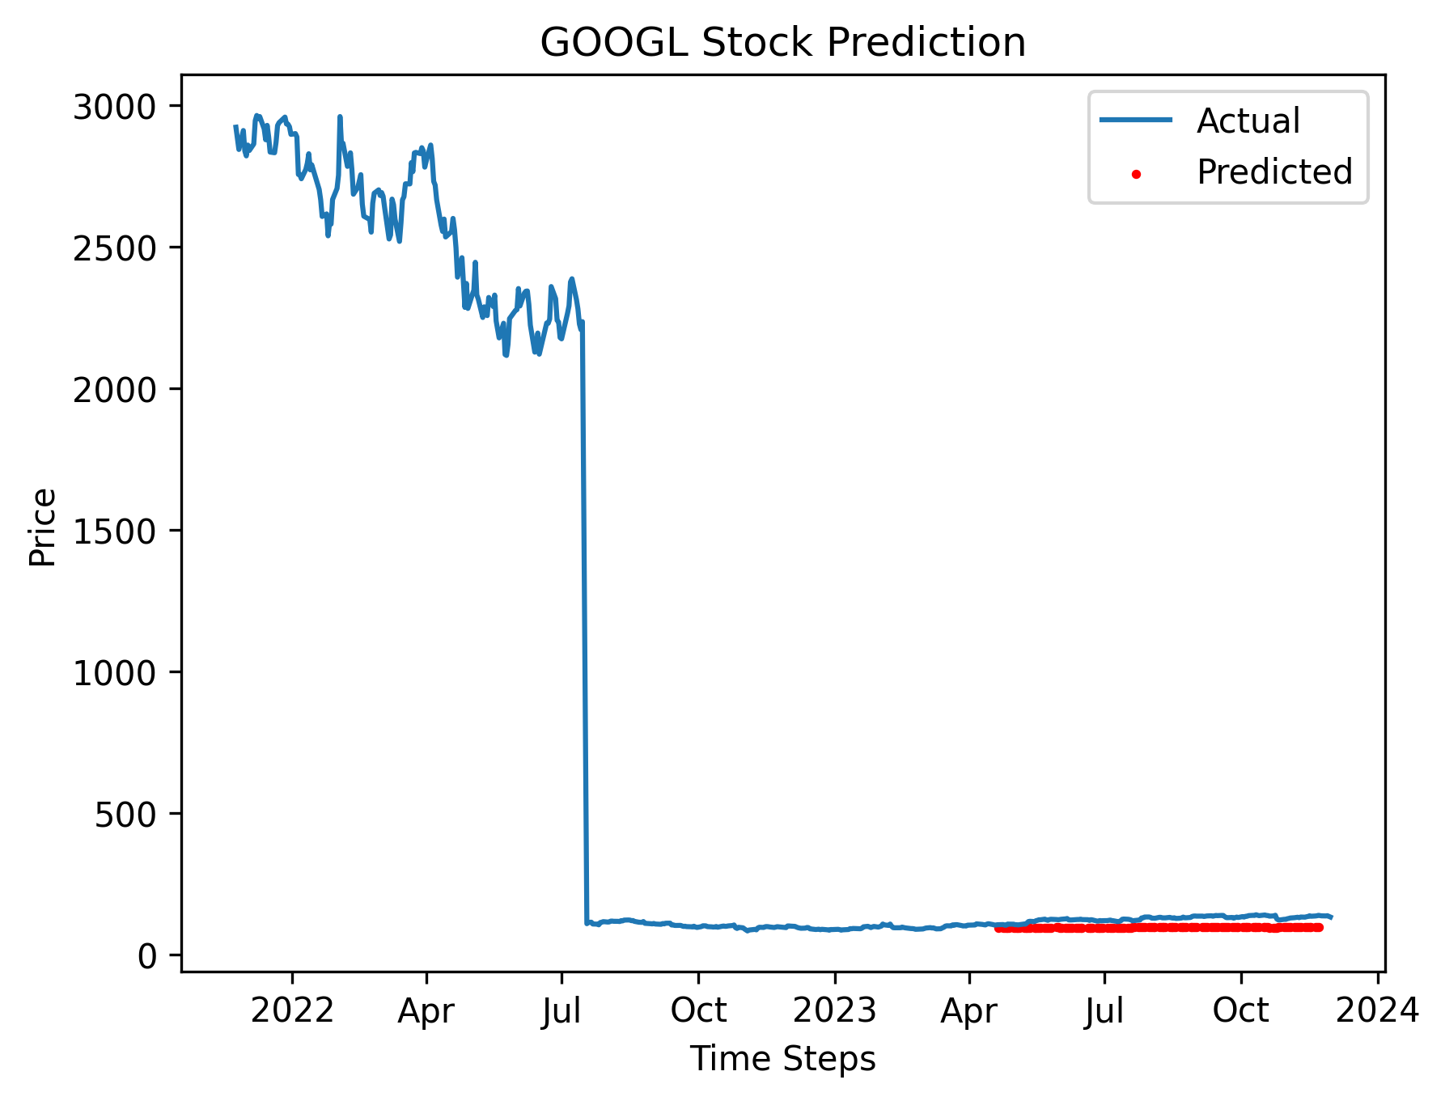
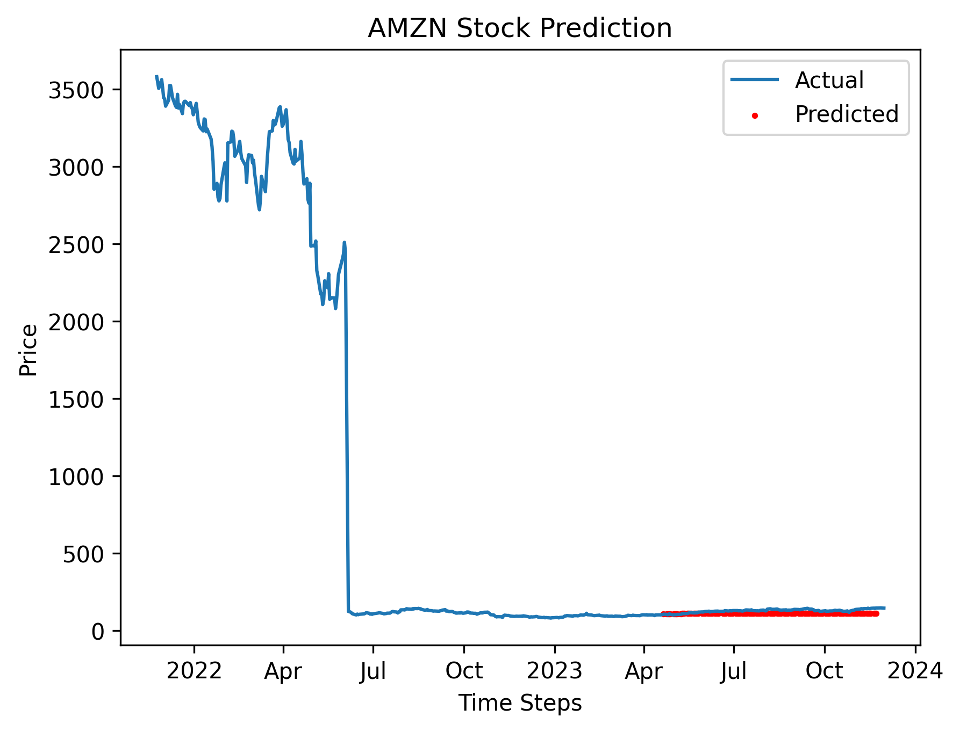
Challenges in Predictions - QLSTM
Quantum Financial Forecasting

Slide 9
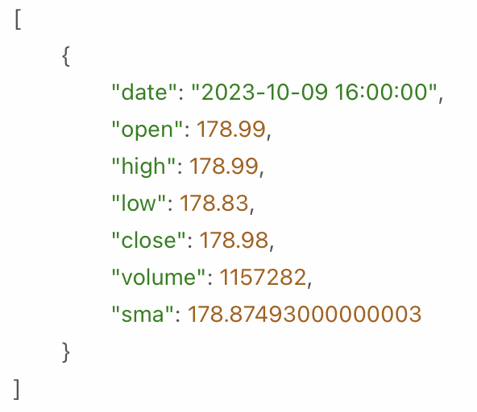
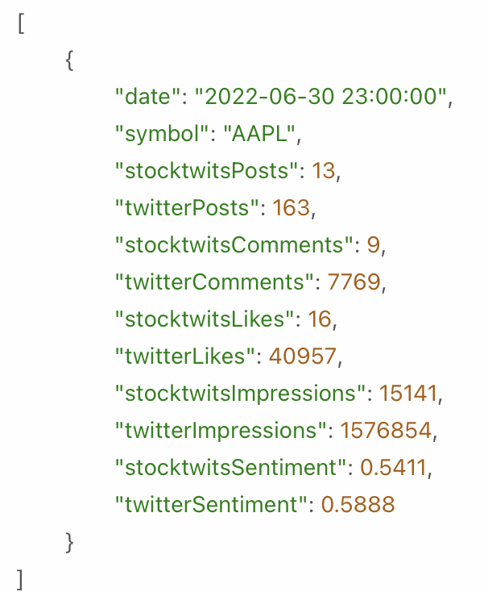


Solution Approach - Datasets
Refine our datasets using Financial Modelling Prep
Technical Indicators
Simple Moving Average (SMA)
Exponential Moving Average (EMA)
Social Sentiment
Public opinion on stock development based on social media activities
Quantum Financial Forecasting

Slide 10
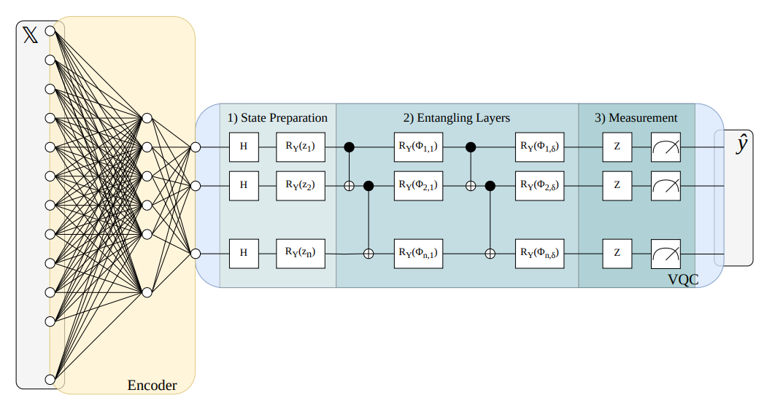
Solution Approach - Model
Refine our model using different approaches
Dimension Reduction
Principal component analysis (PCA)
Autoencoder e.g., Variational Autoencoder (VAE)
Amplitude Encoding from PennyLane
Quantum Financial Forecasting

Slide 11
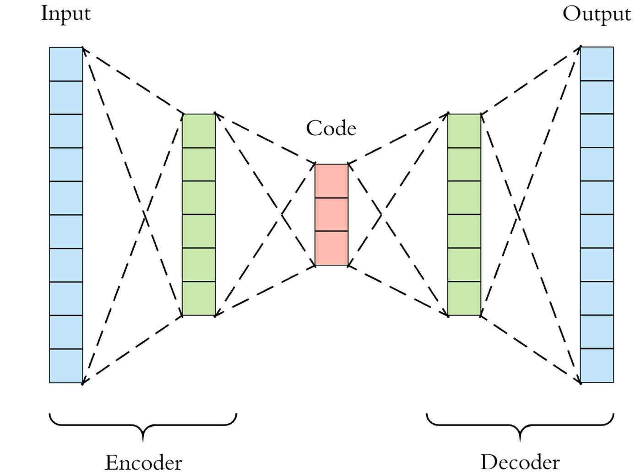
Autoencoder
→ Number of stock data indicators can get very large
only a small amount of qubits are available
→ reduction of dimensionality with a VAE to shrink the amount of inputs down to the number of used qubits
Quantum Financial Forecasting

Slide 12
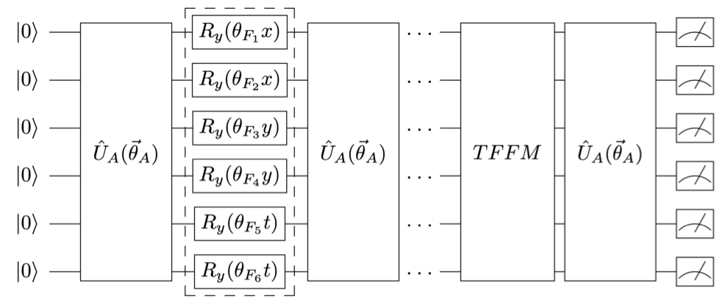
Optimization
Hyperparameter Optimization
Number of qubits
Sequence length
Learning rate
Batch size
Different Architectures
Number of layers
Different rotations in the Variational layer
Trainable parameters in the encoding layer [1]
Quantum Financial Forecasting

Slide 13
Outlook
Visualize the performance data of each model and compare them
Modify model to predict next two weeks based on its own predictions
Predict stock price movements
Test on real hardware
Extra: Predict first 2 weeks of stock data from January 1st 2024, show results on 4th Milestone
Quantum Financial Forecasting

